Slide 1
DEEP LEARNING
The TL challenge
Jose Antonio Ruiz Heredia
Hector Carlos Flores Reynoso
Alvaro Honrubia

Slide 2
THE PROBLEM
Problem
Scope
Observations
Given a set of images (224px, 224px) create a classifier that is able to detect the vehicle type
Refine the Convolutional Neural Network and optimize its parameters
Models are compared using metrics such a mean accuracy, recall and precision

Slide 3
THE PROCESS
00
01
02
03
Models Exploration
VGG16
VGG19
Xception
InceptionResNetV2
Adjusting parameters
Data Augmentation in Model
RandomFlip
RandomRotation
RandomZoom
Data Augmentation in Processing
ImageGenerator
Layer Unfreeze
All layers freeze
Unfreeze the last 15
Unfreeze the last 35
Unfreeze the last 50
Base Model

Slide 4
MODEL ARCHITECTURES
00
01
02
03
Base Convolutional
VGG Model
VGG16
VGG19
ResNet
ResNet50
Xception
Xception
04
05
06
07
InceptionResNetV2
InceptionResNetV2
Data Augmentation in Model
RandomFlip
RandomZoom
RandomRotation
Data Augmentation in Processing
ImageDataGenerator
Layer Unfreeze
All layers freeze
Unfreeze last 50 layers
Unfreeze las 35 layers
Unfre

Slide 5
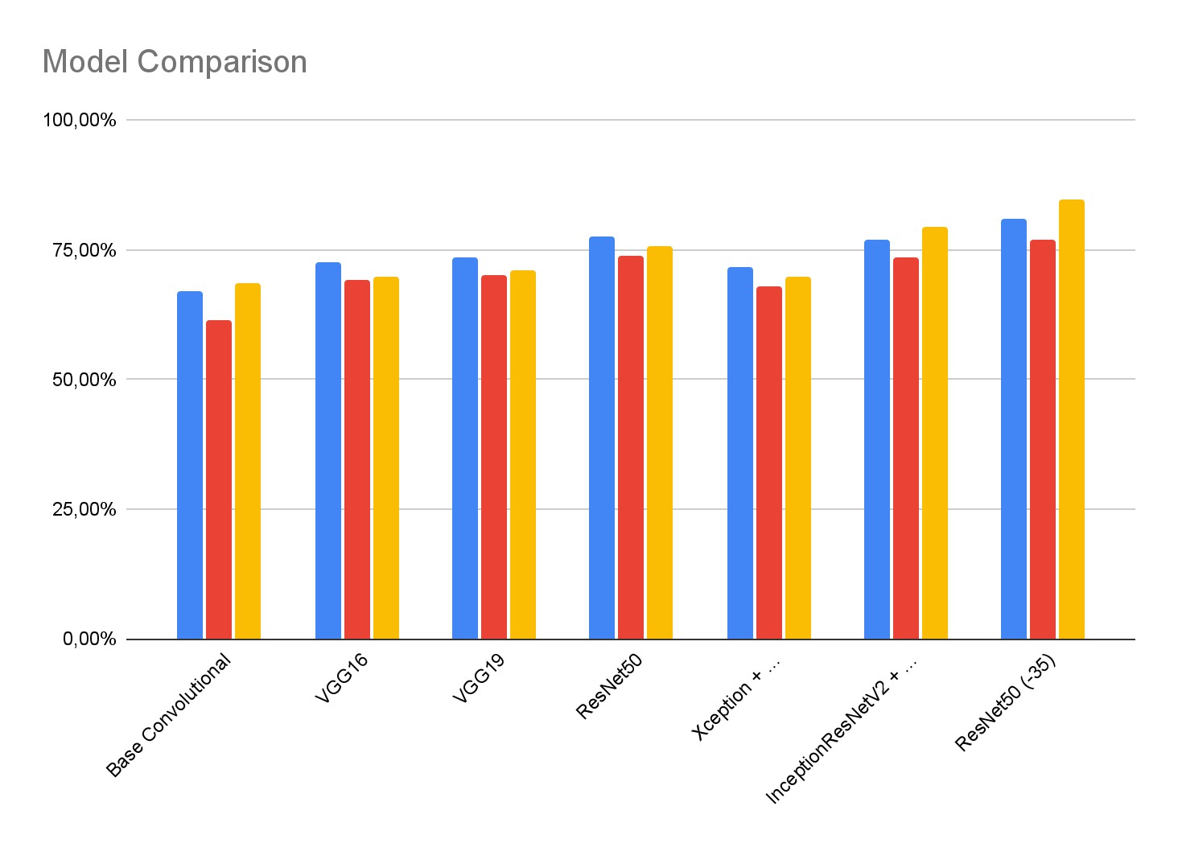
MODEL METRICS
BEST MODEL
Mean accuracy: 81.01%
Mean recall: 76.92%
Mean precision: 84.85%
Accuracy
Recall
Precision

Slide 6
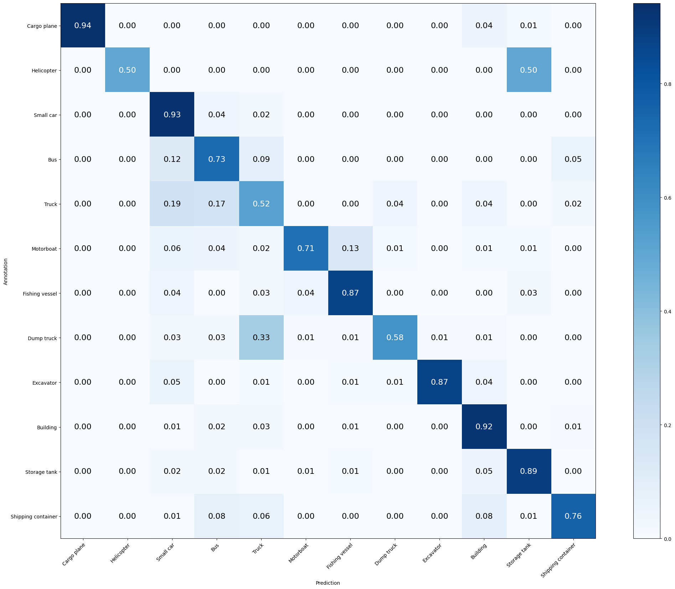
BEST MODEL
Mean Accuracy: 81.010%
Mean Recall: 76.919%
Mean Precision: 84.852%
> Cargo plane: Recall: 94.118% Precision: 100.000% Specificity: 100.000% Dice: 96.970%
> Helicopter: Recall: 50.000% Precision: 100.000% Specificity: 100.000% Dice: 66.667%
> Small car: Recall: 93.095% Precision: 79.796% Specificity: 94.237% Dice: 85.934%
> Bus: Recall: 73.059% Precision: 62.500% Specificity: 94.997% Dice: 67.368%
> Truck: Recall: 52.453% Precision: 59.149% Specificity: 94.875% Dice: 55.600%
> Motorboat: Recall: 70.787% Precision: 90.000% Specificity: 99.658% Dice: 79.245%
> Fishing vessel: Recall: 87.013% Precision: 77.011% Specificity: 99.030% Dice: 81.707%
> Dump truck: Recall: 58.120% Precision: 81.928% Specificity: 99.258% Dice: 68.000%
> Excavator: Recall: 87.179% Precision: 98.551% Specificity: 99.951% Dice: 92.517%
> Building: Recall: 92.339% Precision: 91.968% Specificity: 97.564% Dice: 92.153%
> Storage tank: Recall: 88.889% Precision: 93.151% Specificity: 99.496% Dice: 90.970%
> Shipping container: Recall: 75.974% Precision: 84.173% Specificity: 98.891% Dice: 79.863%

Slide 7
CONCLUSIONS
ResNetV2 Performance
Resource Allocation
Efficiency in Training
Data Augmentation yields better results
Generalization in training can yield bias
Best-performing model, demonstrating superior accuracy and generalization on the validation set.
By using pre-trained weights, the model quickly adapts to new dataset features
As we progress into higher and more complex models, we need to adjust our resource expectations
Data Augmentation leads to improved performance, as it exposes the model to a variety of unseen scenarios during training, enhancing generalization
Large Models are trained around multiple categories, unfreezing the last layers help capture the fine details or your dataset

